Slide 1
How to Swing Trade AAPL, AMZN, FB, GOOGL, NFLX, TSLA, and TWTR
Presented By
Andrew Keene and James Ramelli

Slide 2
RISK DISCLAIMER
Day trading, short term trading, options trading, and futures trading are extremely risky undertakings. They generally are not appropriate for someone with limited capital, little or no trading experience, and/ or a low tolerance for risk. Never execute a trade unless you can afford to and are prepared to lose your entire investment. All trading operations involve serious risks, and you can lose your entire investment. No trades are recommendations or advice and we cannot be sued for losses of capital. All trades are for educational purposes only. Contact your broker or RIA for execution, margin, and other capital requirements. Everyone watching presentation adheres to ALL disclaimers on www.optionhacker.com and www.keeneonthemarket.com

Slide 3
Andrew Keene
- Studied Finance at the University of Illinois before becoming a market maker on the trading floor at the CBOE.

Slide 4
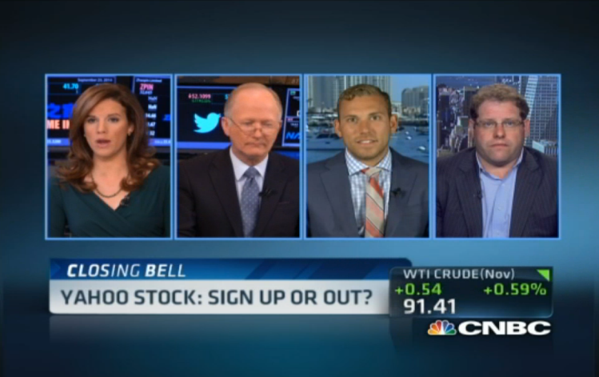
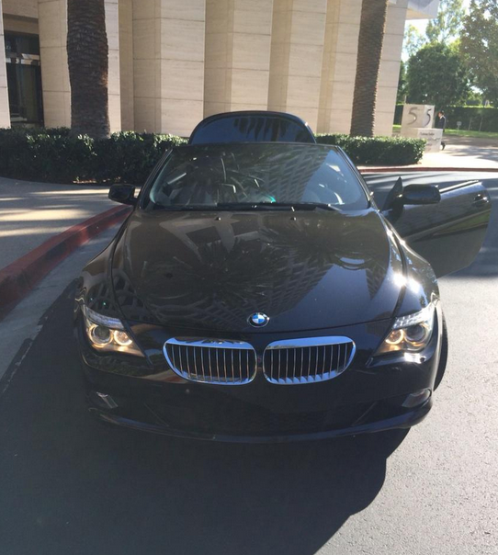
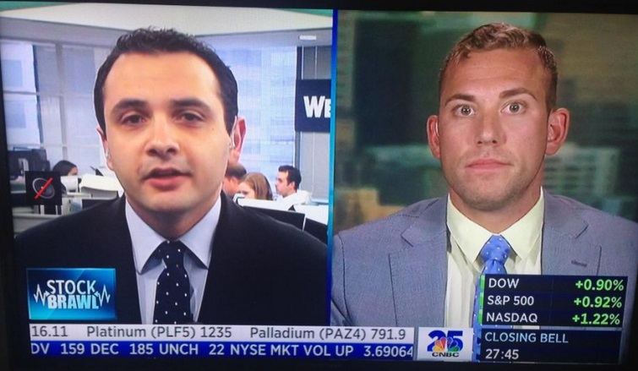
Andrew Keene
Now trades and moderates From San Diego,CA.
Regular guest on CNBC, Bloomberg, Fox Business, BNN Canada.
Floor Trader @ CBOE for 10+ Years

Slide 5
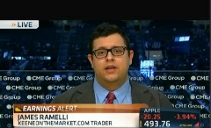
James Ramelli
Active Trader in Futures, FX, Stocks & Commodities and Options
Regular Contributor to CNBC, Bloomberg, Fox Business, BNN Canada.
Writes for Futures Magazine, Active Trader, Resource Investor, CME OpenMarkets

Slide 6
90% of All Traders Lose Money. Why?
You’re brain tells you that you should buy stock as it goes lower and sell it as it goes higher.

Slide 7
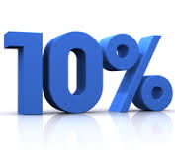
90% of All Traders Lose Money. Why?
Trading isn’t easy. Only 1 in 10 traders is profitable.

Slide 8
Learn From a Pro
Renewals for our services
78%

Slide 9
Swing Trading Review

Slide 10
Provide Fresh Trading Ideas
We are trying to teach traders how to trade as a day trader AND a swing trader.
As with all of our trading plans you must remember:
We can teach you how to trade, but cant click your mouse.

Slide 11
Put Probability in Your Favor
We have traded thousands of stocks with mixed results
We only teach and educate our traders with what makes us money over time.
Let us be your guinea pig in trading while risking our own money, not yours.

Slide 12
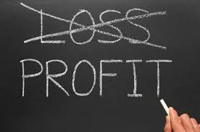
Take the Emotion out of Trading
"The key to trading success is emotional discipline."
Paul Tudor Jones
We teach methodical and systematic plans take help a trader control their emotions in winning and losing setups
By having a very specific plan I remove emotions from the equation

Slide 13
Trend is Your Friend
We have to make sure that our ideas have worked well in the past. We look at the cloud for guidance and to determine if a stock is a candidate for this strategy.
Trading Range vs. Trending Stocks

Slide 14
Can I trade this for Futures, Forex, and Options? YES YES YES YES

Slide 15
Teach me How to Trade this with ALL products:
We will focus on stocks but the same concepts can be applied to ANY market
With this strategy I can trade…
Forex
Futures
Stock
Options

Slide 16
Forex Trades BEST on the 4 Hour Bar:
Each Product has a Timeframe that Works Best:
Forex- Generally I will look to use a 4 hour bar when swing trading forex.
Currency pairs are not as volatile
They don’t gap often
They are always trading
Look at the 4 hour bar in the AUD…

Slide 17
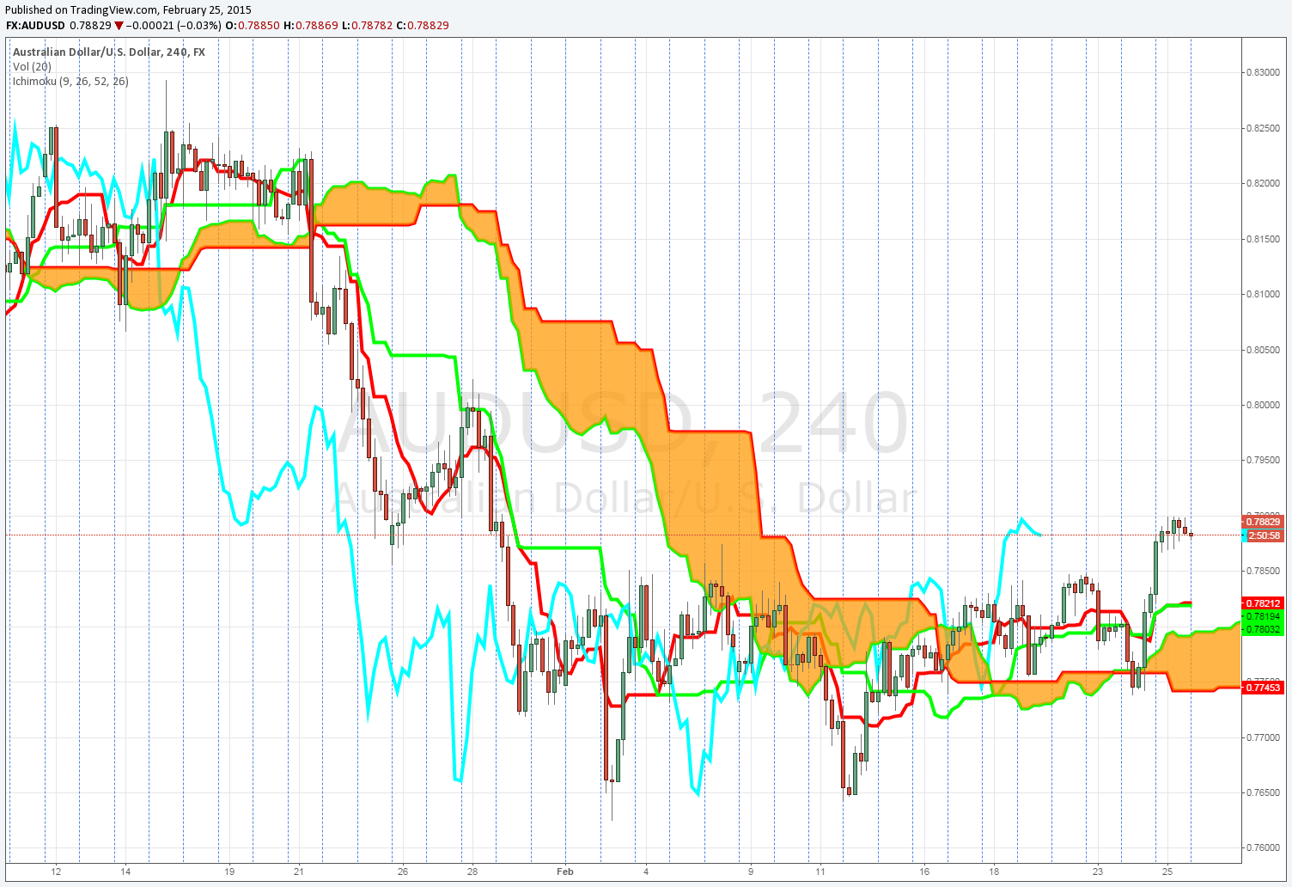
AUD/USD Example
AUD Short Signal
Why is the upside break not a long signal?

Slide 18
What timeframes we use for confirmation?
Confirmation:
Forex-
We also want to look at longer timeframes as well for confirmation. If they all line up it is a good signal.
Weekly
Daily
4hr Bar

Slide 19
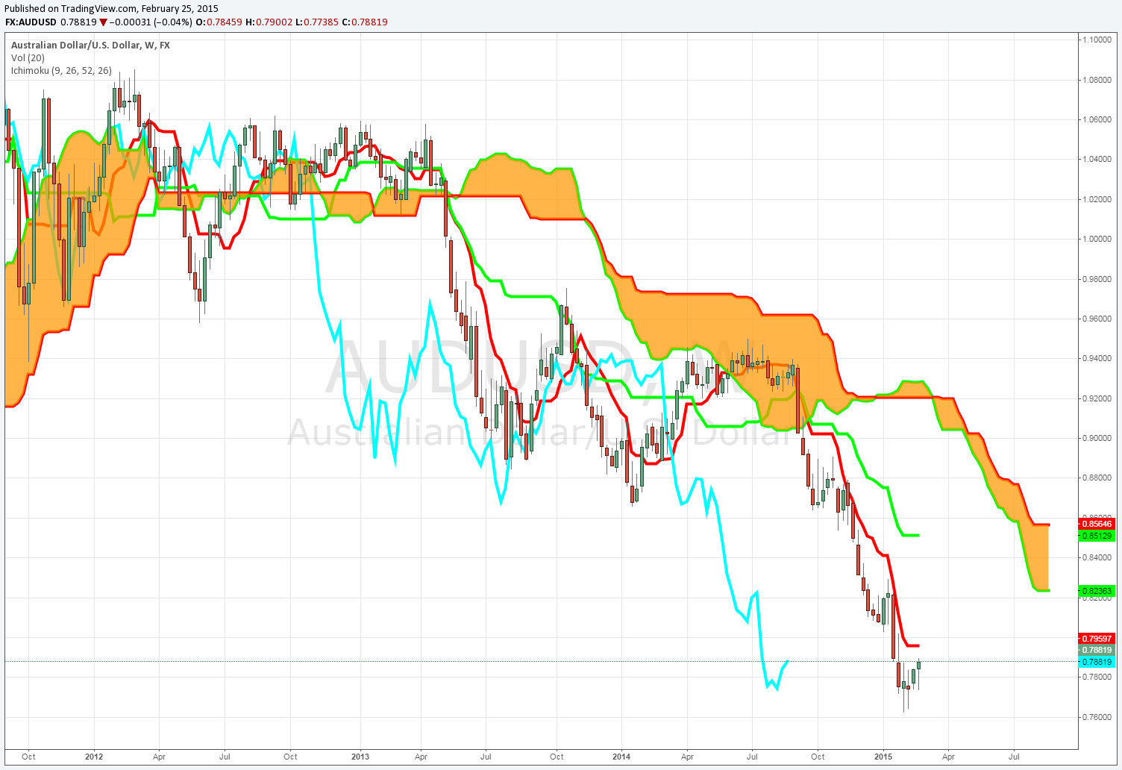
AUD/USD Example
AUD has not been above the cloud on the weekly since April of 2013
I can take short setups but any long setup does not have confirmation.

Slide 20
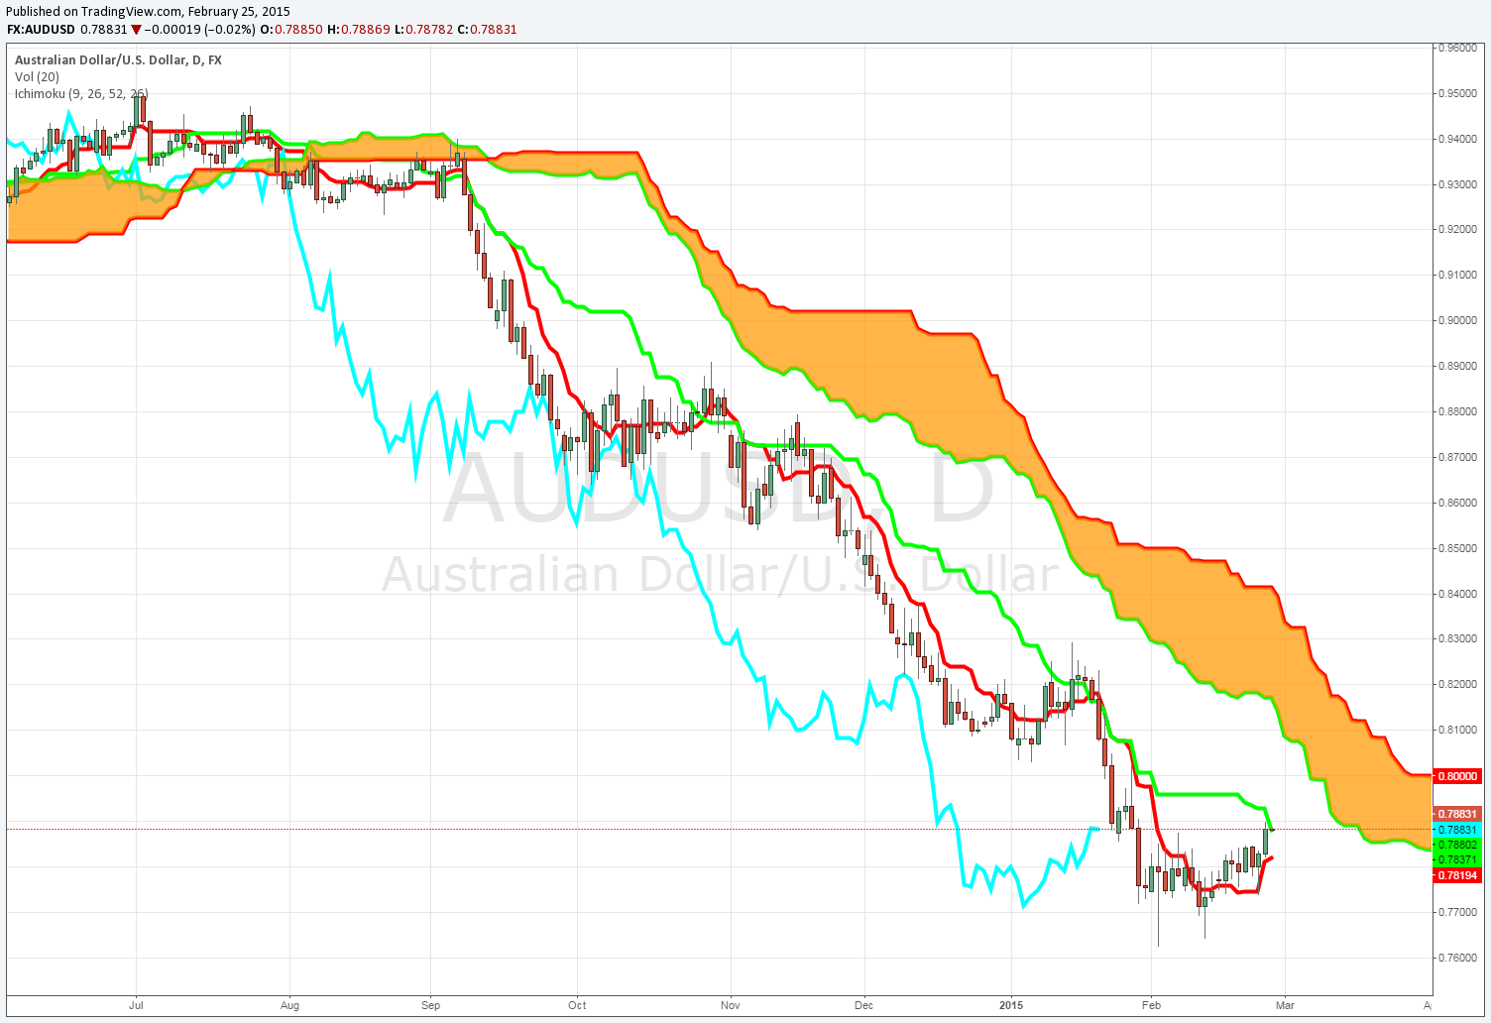
AUD/USD Example
Daily is extremely bearish as well, again no confirmation of any long setups. I am only looking for shorts on downside breaks on the 4hr bar

Slide 21
AUD/USD Example
AUD Short Signal
No trades in this region, I can only look for longs if daily or weekly clouds change.

Slide 22
We want the HIGHEST Probability Possible
Confirmation:
When swing trading we want ALL of these charts to line up, if they don’t then it is not the highest probability trade setup.

Slide 23
Futures trades BEST on the Daily Chart.
Futures:
There are all kinds of listed futures but for swing trading the daily bar still works best:
Futures trade all day
Less gaps
Again we want the multiple time frame confirmations. Look at the E-Mini S&P 500 Futures.

Slide 24
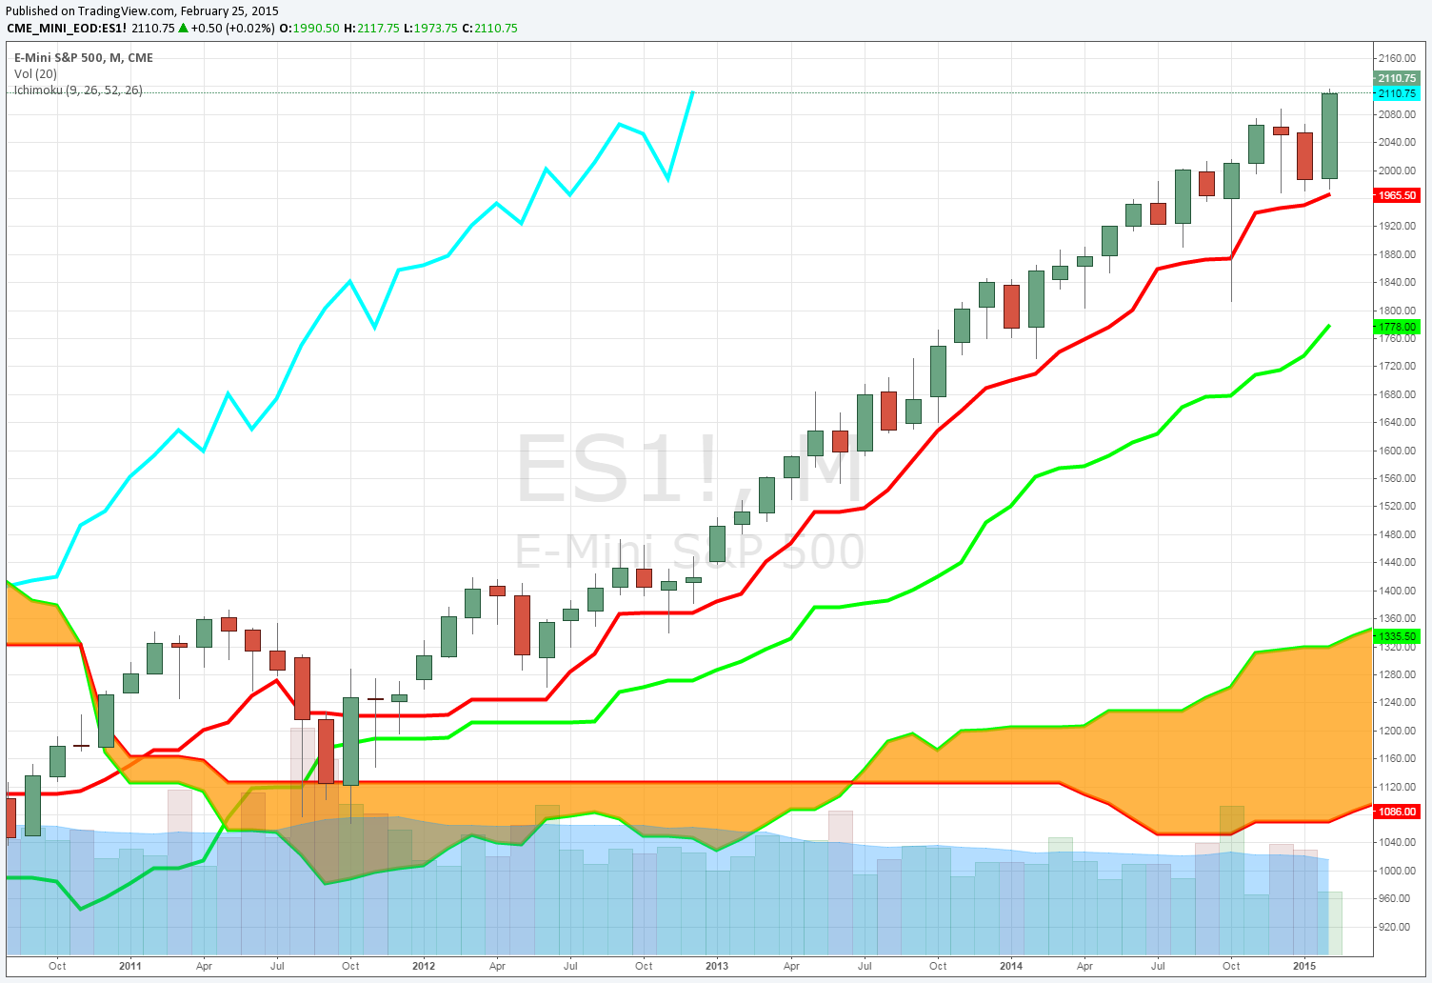
E-Mini S&P 500 Example
Same for the Monthly chart…

Slide 25
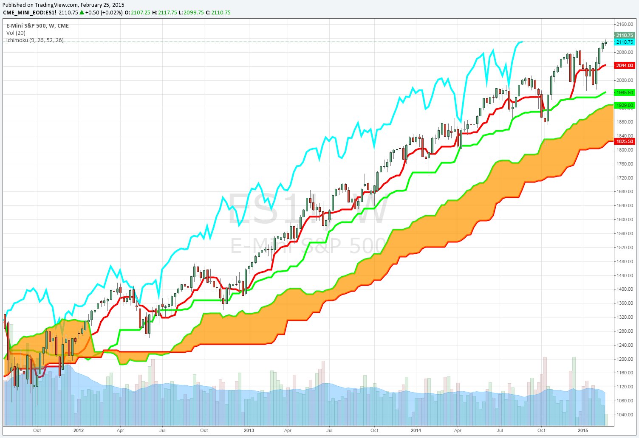
E-Mini S&P 500 Example
The weekly S&P 500 futures chart has not been below the cloud since November of 2011

Slide 26
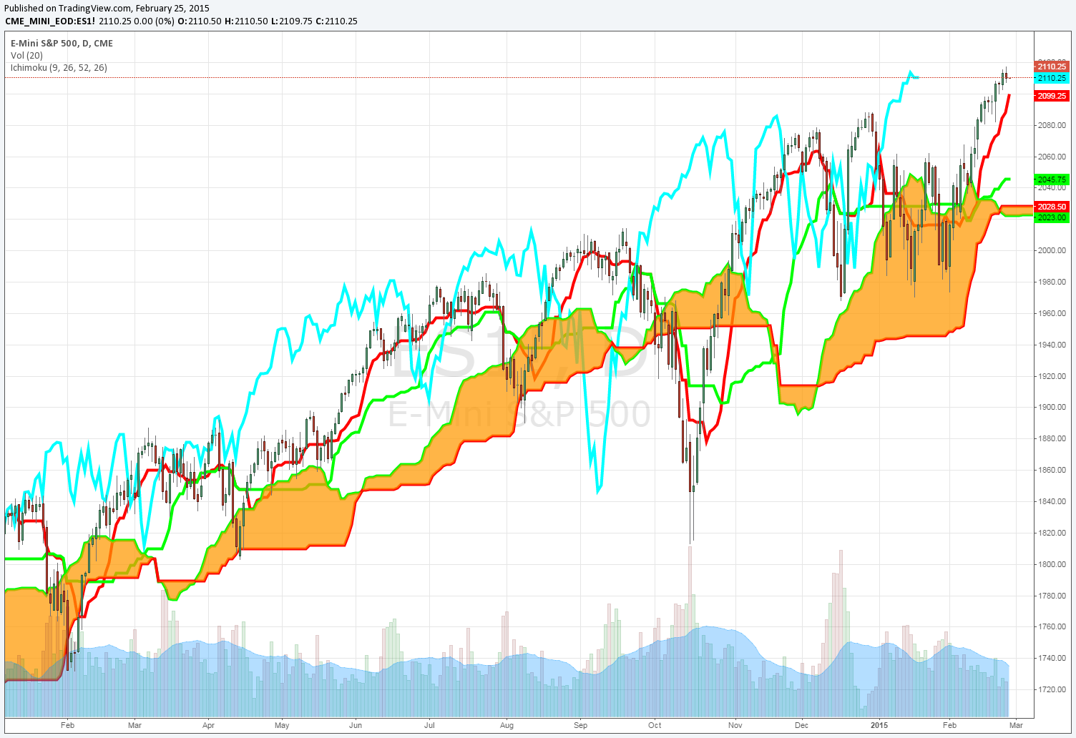
E-Mini S&P 500 Example
Long Signals on the Daily
2.13.2014 at 1824.25
4.15.2014 at 1839.50
8.18.2014 at 1967.50
10.31.2014 at 2011.50
1.09.2015 at 2055.00
1.22.2015 at 2056.50
2.3.2015 at 2042.00
Why was the short signal ignored?

Slide 27
Which Timeframe Works Best for Each Product
Futures:
Again, a trader can take short setups in the S&P futures but they need to understand that without multiple levels of confirmation there is a lower chance of success.

Slide 28
Stocks work BEST on the Daily Chart
Stocks:
There are thousands of listed stocks that a trader can trade. This means there are always opportunities.
For stocks I want to take my signals off of the daily chart: Cloud breaks
Confirmation on multiple time frames
If this seems too selective you need to keep in mind just how many stocks are out there. There's plenty of setups. Only take the best ones

Slide 29
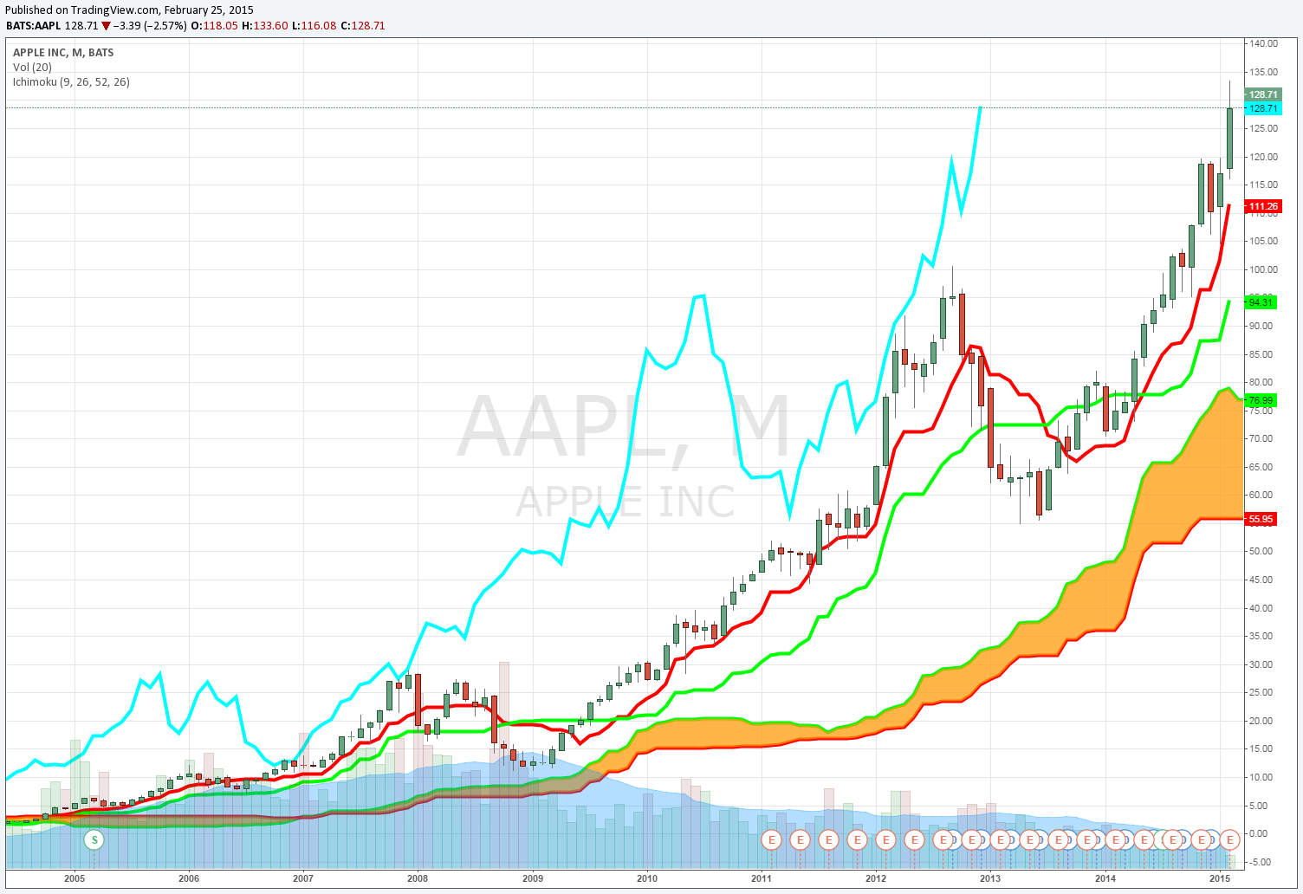
AAPL Chart Example
Weekly Chart hasn’t been below cloud since October of 2013

Slide 30
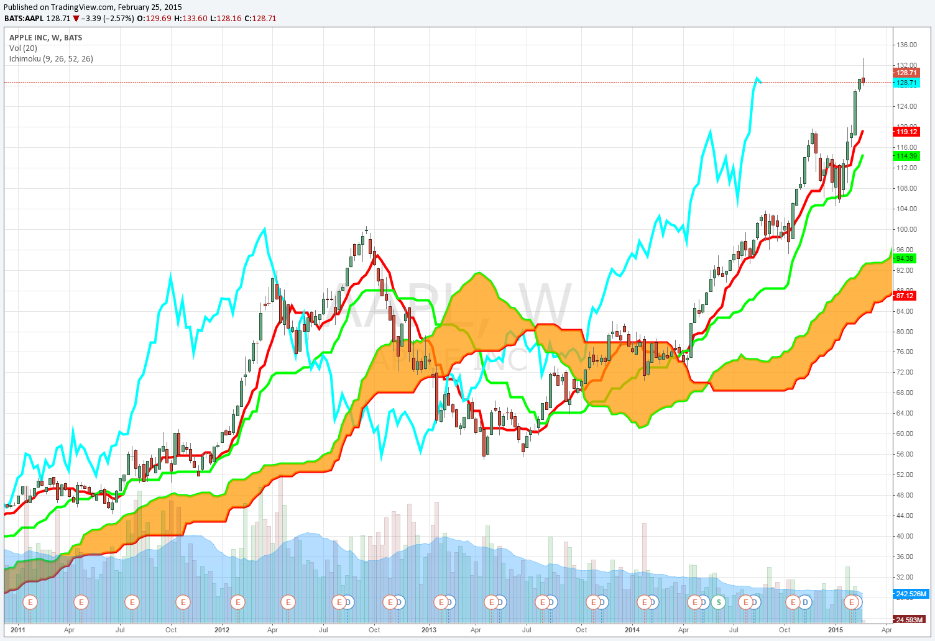
AAPL Chart Example
Weekly Chart hasn’t been below cloud since October of 2013

Slide 31
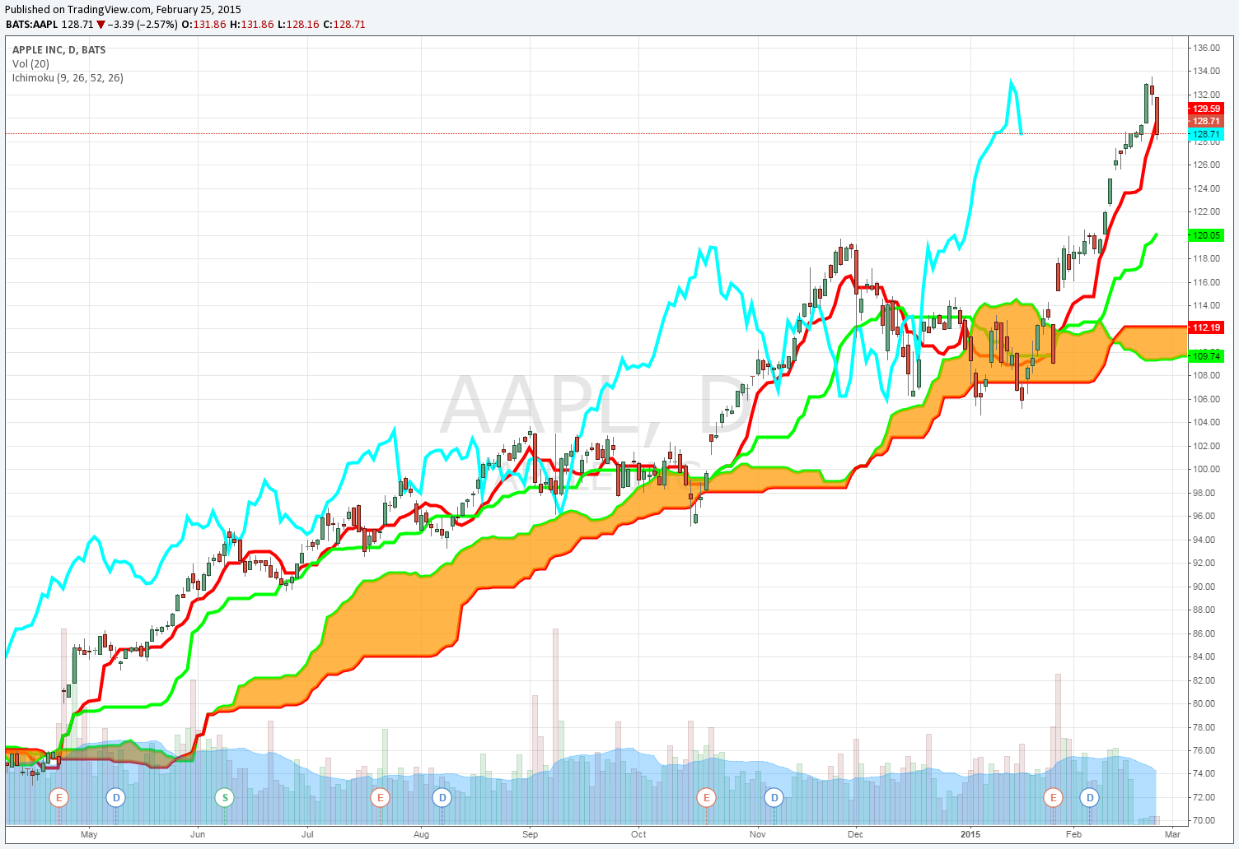
AAPL Daily Chart Example
We got Long Signals:
4.24.2014 at $81.11 10.20.2015 $99.76
1.28.2015 at $115.69
Again I am only looking for longs because of the weekly and monthly charts

Slide 32
Which Timeframe Works Best for Each Product
Stocks:
I can be the most selective in my stock setups because there are SO MANY of them. I want confirmation on all 3 time frames.

Slide 33
How Do I set this Up for Good Reward to Risk Setups?

Slide 34
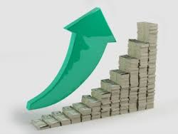
What is a Swing Trade?
A Swing Trade can have a large time frame:
Swing trades have a holding period of one week to 6 months.
Outside of 6 months this becomes more of an “investment” or a “position.”
http://bit.ly/1wwCyxf

Slide 35
Time Frame for the Cloud
Increase Probability With the Cloud:
Swing Trading: I use the daily, weekly, and monthly charts to increase my probability.
http://bit.ly/1wwCyxf

Slide 36
Swing Trade Example in AAPL
First we break down longer time frames:
1. We start with the monthly chart
2. Then we look at the weekly chart for more accuracy.
3. Then we look at the daily for signals.

Slide 37
AAPL Chart Example
Monthly Chart hasn’t been below cloud since October of 2013

Slide 38
AAPL Chart Example
Weekly Chart hasn’t been below cloud since October of 2013

Slide 39
AAPL Daily Chart Example
Most recent long signal in AAPL

Slide 40
Trading A Swing Trade Signal in AAPL
So Once I have the Signal how do I trade it?
The best thing about trading is that there are always many different ways to do something.
I can trade the signal with:
Stock
Options
Options Spreads
A strategy can be made for any skill level and risk tolerance.

Slide 41
Stock Swing Trade in AAPL
The simplest setup is going to be with stock:
AAPL Trade:
Buy AAPL at $115.69 with a $106.69 stop
Targets:
Sell 25% at $120.19 50% of the stop
Sell 25% at $124.69 100% of the stop
Sell 25% at $129.19 150% of the stop
Sell 25% at $133.69 200% of the stop
My targets and stop are entered at the start of the trade and are not changed. No emotion.

Slide 42
STOP Losses for Beginner & Intermediate Trader
Stop Losses:
Buy AAPL at $115.69
Beginner: 2% Stop Loss: or roughly $3.14
Intermediate: 5% Stop Loss or Roughly: $5.78
Expert: Under the Cloud: $9.00 STOP

Slide 43
Picking the BEST Options for BEST ROI

Slide 44
Trading A Swing Trade Signal in AAPL
What if I want to take an options trade?
If I'm going to take an options trade I need to first determine what my measure move target is.
I use this level to determine how much I think a stock can move in a certain time period. I use these levels for outright options and spreads.

Slide 45
Measured Move Targets
To set up trades to fit into your plan you first must calculate the measured move targets:
Targets: Strike Price + ATM Straddle Price Strike Price – ATM straddle Price
These calculate targets BY EXPIRATION. So I can get a target in almost any timeframe as long as there is an expiration

Slide 46
Measured Move Targets
When the AAPL signal hit Jan 28th 2015:
I wanted to calculate targets 3 months, 6 months and 1 year out:
3 month Target: The Apr 115 Straddle = $11.65 + 115 strike = $126.65
6 month target:
The Jul 115 Straddle = $17.50 + 115 strike = $132.50
1 year target:
The Jan16 115 Straddle = $26.00 + 115 strike = $141.00

Slide 47
Measured Move Targets
Now that I have my targets I want to set up a trade:
I want to buy the strike where I think the stock can go.
I don’t want a positon for 1 year, that’s not a swing trade.
I want something 3-6 months out using the targets I have.

Slide 48
Call Options Trade in AAPL
Options Trade:
Beginner:
Buy the July 130 Calls for $3.45 (50% stop)
Targets:
Sell 25% at $4.25
Sell 25% at $5.25
Sell 25% at $6.25
Sell 25% at $7.25
Target #1 was hit the next day!
All other targets have already been hit!

Slide 49
STOP Losses for Beginner & Intermediate Trader
Stop Losses:
Buy the July 130 Calls for $3.45
Beginner: 20% Stop Loss: or roughly $.70
Intermediate: 50% Stop Loss or Roughly: $1.75
Expert: NONE

Slide 50
The Easiest Signal to take
If a trader bought AAPL July 130 Calls on our signal at $3.45
With a $1.75 stop the trade breaks down like this: Risk: $175 per 1 lot Reward: Unlimited
With Exits at targets:
If a trader bought 100 lot: $23,000 in profits
If a trader bought a 50 lot: $11,500 in profits
If a trader bought a 20 lot: $4,600 in profits

Slide 51
Buying Calls has Time Decay and Vega Risk
1. Trader likes own premium, get huge profits, not spread a position:
Long Calls or Puts using the measured Move Target:
Makes or loses money on theta, implied vol, and moves in the stock.
Buy the July 130 Calls for $3.45
Targets:
Sell 25% at $4.25
Sell 25% at $5.25
Sell 25% at $6.25
Sell 25% at $7.25
All Targets hit!

Slide 52
BEST Possible ROI Trade
2. Call or Put Butterflies: Great risk vs. reward, profits in a huge range, small movements on a daily basis.
Buy the AAPL July 115-135-155 Call Fly for $4.40 Risk: $440 per 1 lot Reward: $1560 per 1 lot Breakeven: $119.40 and $150.60
Spread is currently trading at $7.00
Nearly 60% return on investment

Slide 53
Make Money if Stock is Flat, Higher, or Lower
3. Sell Put Spreads: Makes money in a wide range, little movement on a daily basis, makes money if stock is flat, higher, or slightly lower.
Sell the AAPL July 105-95 Put Spread for $2.40 Credit Risk: $760 per 1 lot Reward: $240 per 1 lot Breakeven: $102.60
Spread is currently trading at $0.80 Nearly 11% return on risk.

Slide 54
BONUS BONUS: Using These Concepts to Day Trade

Slide 55
What is a Day Trade?
We Say “WLD” for all of Our Day Trades:
A day trade is closed at the end of the trading day win, lose or draw.
My favorite stocks to day trade are AAPL, BABA GPRO, FB, TSLA, and TWTR.

Slide 56
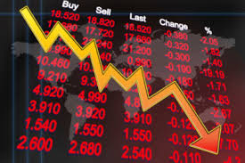
Using the Cloud
I Use the Ichimoku Cloud:
I use the cloud everyday
I use the 5 and 15 min bars for setups
I look at cloud thickness, trend, and other indicators like average true range.
Trades like this are closed by the end of the day.
http://bit.ly/134Z1Vr

Slide 57
Timeframe
For Day Trading Stock:
I take my signals off of the 5 min bar. Like with my swing trades I can check against longer time frames for confirmation.
Daily bar
30 min bar
Look at an example in AAPL from Feb 4th
http://bit.ly/134Z1Vr

Slide 58
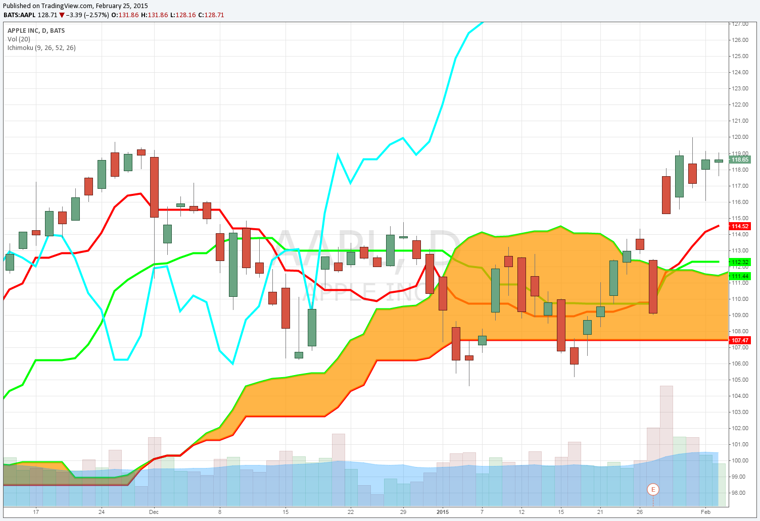
AAPL Day Trade Example
Feb 4th 2015
Stock is above the cloud on the cloud on the daily, second level of confirmation

Slide 59
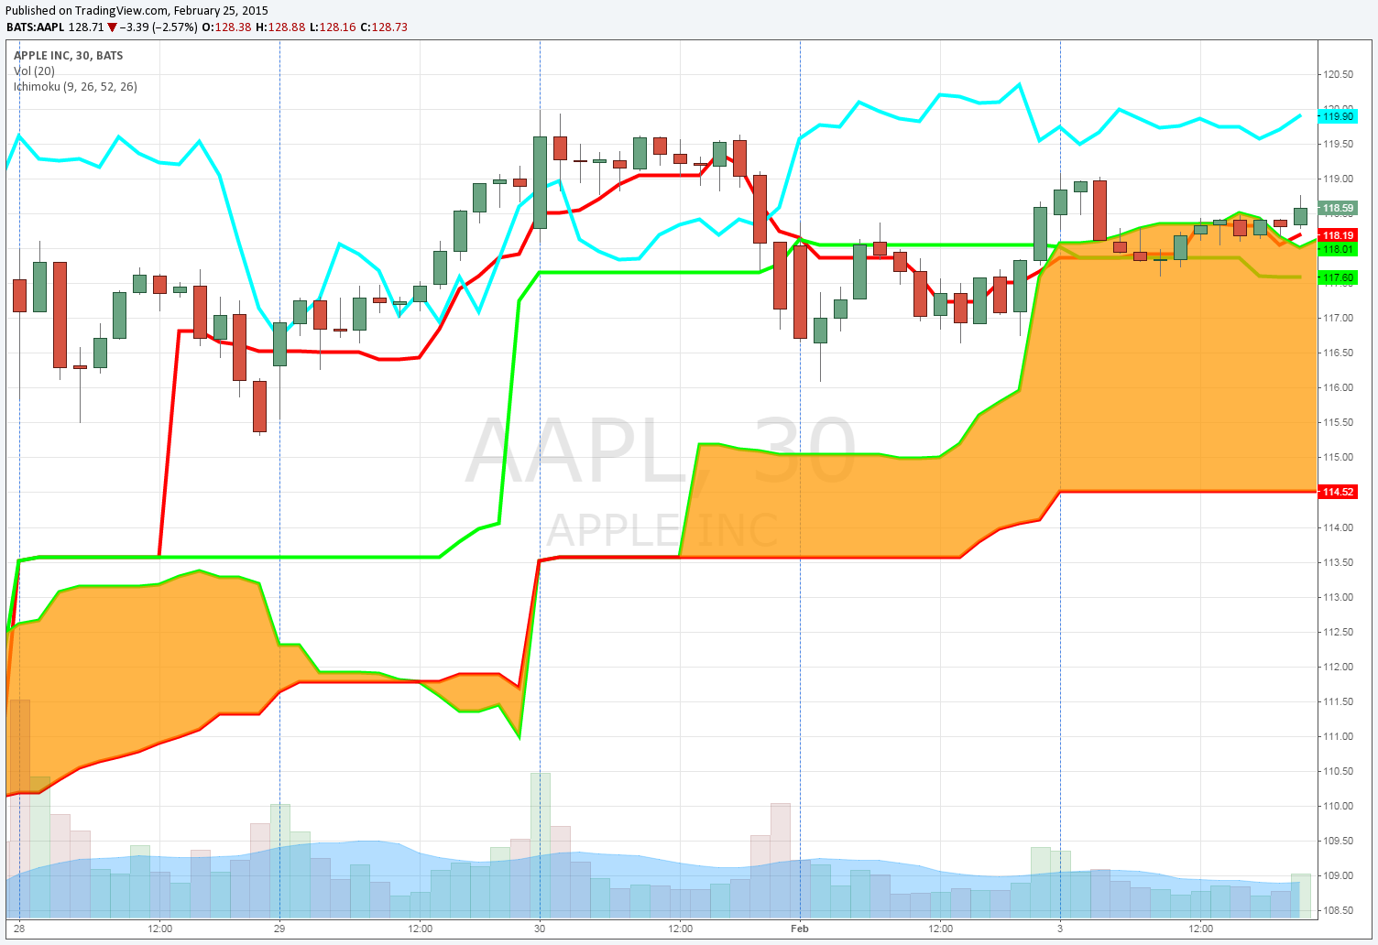
AAPL Day Trade Example
Feb 4th 2015
Stock is above the cloud at the previous days close on the 30 min bar, this is first level of confirmation

Slide 60
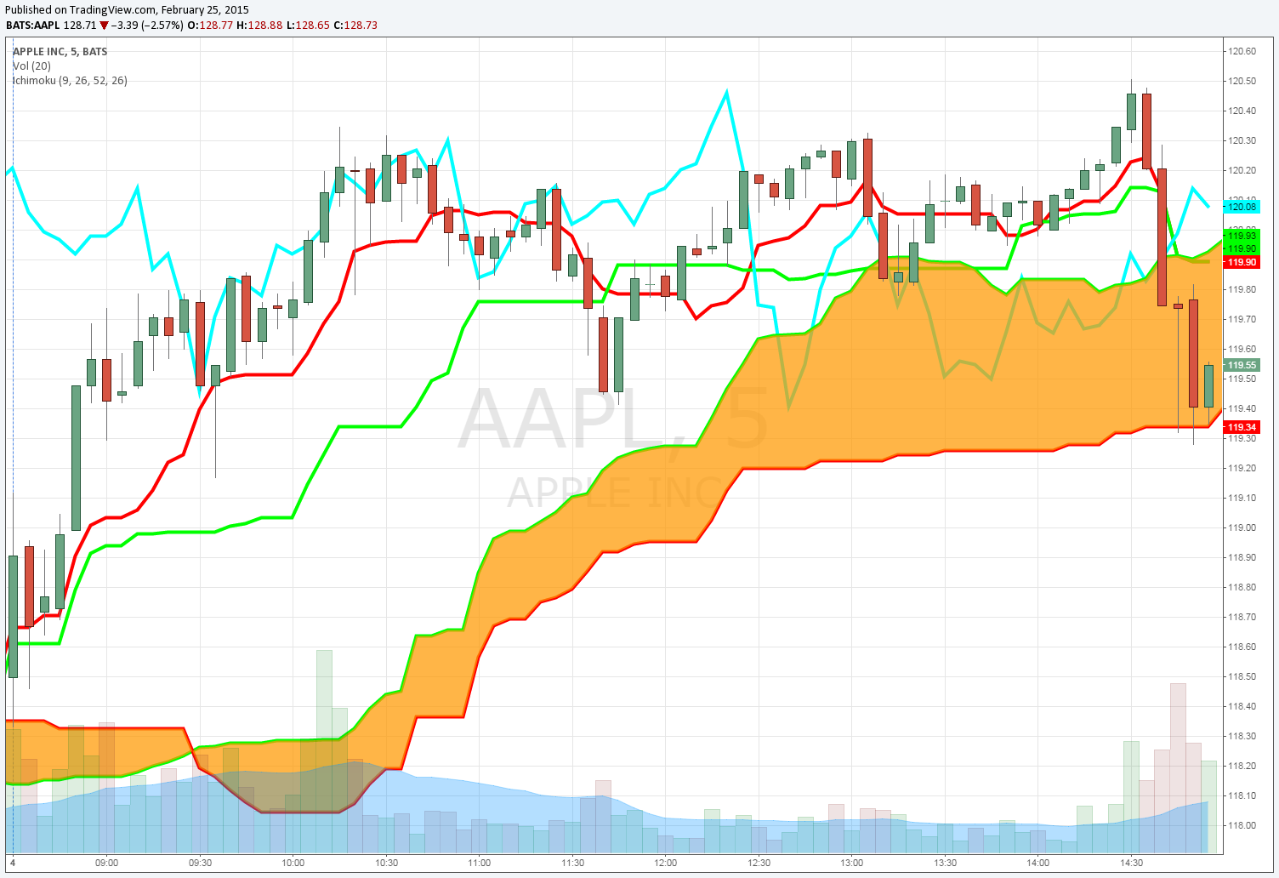
AAPL Day Trade Example
Feb 4th 2015
Long Signal at the close of first 5 min bar above the cloud at $118.90
Stop below the cloud at $118.10

Slide 61
Day Trading AAPL
Confirmation on all levels, I want the trade:
Buy AAPL Stock at $118.90 with a stop at $118.10
Sell 25% at $119.30 50% of the stop
Sell 25% at $119.70 100% of the stop
Sell 25% at $120.10 150% of the stop
Sell 25% at $120.50 200% of the stop
AAPL traded as high as $120.51 on Feb 4th meaning all targets would have been hit.

Slide 62
Day Trading AAPL
As you can see I use the same method for determining my stop loss and targets. I can also apply the same ideas to a simple weekly options trade.
I would first determine the average range of the stock, then buy an option at that level. Simple as that!
Watch this simple strategy in practice and you will be AMAZED at how often it works.

Slide 63
Summary of Topics
A trader must know the proper time frames for different products
A trader can apply the same ideas to a wide range of products
Use plans that remove emotion from the equation
Stick to the plan you use
Look for multiple levels of confirmation in all setups
A trader can express the same market view many different ways
Options strategies can be tailored to a trader of any skill level or risk tolerance
Swing trade plans can be applied to day trading setups with little adjustments
All day trades must be closed by EOD
A trader can day trade with stock or with weekly options
Ask yourself what kind of trader you are and what types of strategies are appropriate for you.

Slide 64
Live Workshop: How To Trade the Best Currency Pairs Using The Ichimoku Cloud Early Bird Special Over 80% off! Regularly $499 Thursday April 16, 2015 at 8 pm EST
Learn a Trading Plan with Stop Losses and Targets
Learn Results that have produced about 40% profits in the last 3 years
Learn how to use the Ichimoku Cloud in Forex Markets
Learn our 5 step trading plan for the forex market
Learn the highest probability setups.
http://www.keeneonthemarket.com/earlybirdspecial
312-261-5581
$89

